Slide 1

Cyber attack
By: Sara Hatem
Shaza Muhmad
Rawda Ayman
Omar Adl
Mostafa Hossam

Slide 2

Network security
Network security is as important as your house’s doors and locks.
No network security , then no privacy , more stealing, and more threatening.

Slide 3

Problem
attacks
Weak security
Bad maintaining
Whenever the security get stronger ,on the other side hackers find new techniques to attack your privacy
Weak security cause easier access and attacks
user wasn’t keeping the actual hardware safe
Costs
Usability
High security is expensive
When using weak security passwords or trust unknown websites

Slide 4




CIA Triad
Confidentiality
Integrity
Availability
Keep data private and safe
Only authorized person can view
Protect data from being modified by unauthorized people
Protect data in case of motion and keep it accurate
- Data always available

Slide 5
Solution
Confidentiality
Integrity
Encryption
Strong authentication
Biometric authentication
Data hashing
Data backups
Enforced permissions
Monitor file changes
Use power supplies
Availability
Data redundancy
Data backup
Disaster recovery

Slide 6

Security components
Firewall
IDS/IPS
VPNs
Encryption
access control

Slide 7

Company overview

Slide 8
Business Model
Research​
We based our research on market trends and software sales ​
Abstract​
We believe people need new management tools to help businesses achieve their OKRs​
Design​
Minimalist design and easy to use ​

Slide 9
Market overview
$3B
$2B
$1B
Opportunity to build​
Fully inclusive market​
Total addressable market​
Freedom to invent​
Selectively inclusive market​
Serviceable available market​
​
Few competitors​
Specifically targeted market​
Serviceable obtainable market​
​

Slide 10
Market Comparison
Opportunity to build​
Fully inclusive market​
Total addressable market​
Freedom to invent​
Selectively inclusive market​
Serviceable available market​
​
Few competitors​
Specifically targeted market​
Serviceable obtainable market​
​

Slide 11

Our competition
Contoso​
Competitors​
Our product is priced below that of other task management tools on the market​
Simple and easy to use app and website, compared to the complex tools of our competitors​
Affordability is the main draw for our consumers to our product​
Company A​ Product is more expensive​
Companies B & C ​ Product is expensive and inconvenient to use​
Companies D & E​ Product is affordable, but inconvenient to use

Slide 12
competition
Convenient
Contoso
A
Expensive​
Affordable
B
D
E
C
Inconvenient​

Slide 13
Growth strategy
How we’ll scale in the future​
Feb 20xx
May 20xx
Oct 20xx
Distribute the app to local start ups to help establish the product
Release the app to the general public and monitor press and regional market trends
Gather feedback from the start up community to expand availability of the product

Slide 14
Traction
Forecasting for success​
Key Metrics
Revenue by year
 | clients | orders | Gross avenue | Net revenue
20XX​ | 10​ | 1100​ | $10,000​ | $7,000​
20XX​ | 20​ | 200​ | $20,000​ | $16,000​
20XX​ | 30​ | 300​ | $30,000​ | $25,000​
20XX​ | 40​ | 400​ | $40,000​ | $30,000

Slide 15
Two-year action plan
Supply volunteers​
Run focus groups​
Gather feedback​
20XX
Jan
Feb
Mar
Apr
May
Jun
Jul
Aug
Sep
Oct
Nov
Dec
Test with start ups​
Regional launch​
Deliver to consumers​
20XX
Jan
Feb
Mar
Apr
May
Jun
Jul
Aug
Sep
Oct
Nov
Dec

Slide 16

Financials
 | Year 1 | Year 2 | year 3
Detailers​ | 5,000​ | 40,000​ | 160,000​ | ​
Users​ | 50,000​ | 400,000​ | 1,600,000​ | ​
Sales​ | 500,000​ | 4,000,000​ | 16,000,000​ | ​
Average Price per Sale​ | 75​ | 80​ | 90​ | ​
Revenue @ 15%​ | 5,625,000​ | 48,000,000​ | 216,000,000​ | ​
Gross Profit​ | 5,625,000​ | 48,000,000​ | 216,000,000​ | ​
Expenses​ | ​ | ​ | ​ | ​
Sales & Marketing​ | 5,062,500​ | 38,400,000​ | 151,200,000​ | ​
Customer Service​ | 1,687,500​ | 9,600,000​ | 21,600,000​ | 70%​
Product Development​ | 562,500​ | 2,400,000​ | 10,800,000​ | 10%​
Research​ | 281,250​ | 2,400,000​ | 4,320,000​ | 5%​
Total Expenses​ | 7,593,750​ | 52,800,000​ | 187,920,000​ | 2%​

Slide 17
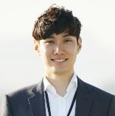
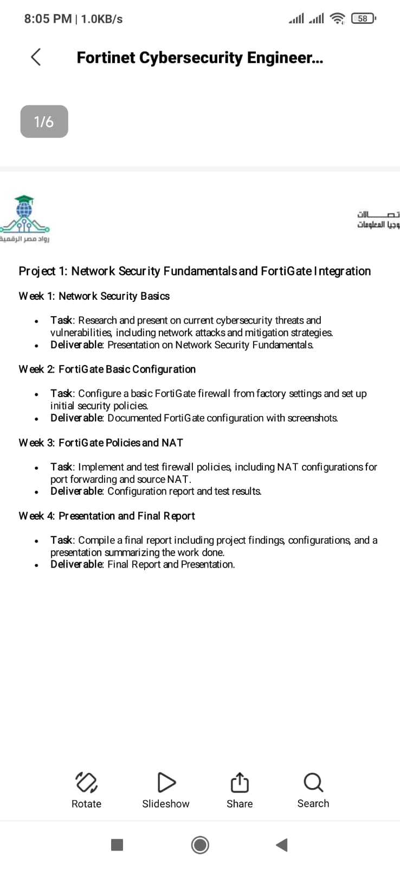
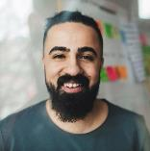
Meet the team
Takuma Hayashi​​
Mirjam Nilsson​​
Flora Berggren​​
Rajesh Santoshi​​
President​
Chief Executive Officer​
Chief Operations Officer​
VP Marketing​

Slide 18





The Full team
Takuma Hayashi​
Mirjam Nilsson​​
Flora Berggren​​
Rajesh Santoshi​​
President​
Chief Executive Officer​
Chief Operations Officer​
VP Marketing​
Graham Barnes​
Rowan Murphy​
Elizabeth Moore​
Robin Kline​
VP Product​
SEO Strategist​
Product Designer​
Content Developer​

Slide 19
Funding
$12K
$14K
$32K
$82K
Campaigns
Angel investments
Cash
Shares
Revenue obtained from online campaigns and reorders
Amount obtained through other investors​
Liquid cash we have
on hand​
Number of shares converted into USD​

Slide 20
Summary
At Contoso, we believe in giving 110%. By closing the loop on task management and using the latest technology, we help businesses grow and nurture a consumer-first mindset. We thrive because of our market knowledge and a great team behind our product. As our CEO says, "Efficiencies will come from proactively transforming how we do business."

Slide 21
Thank you
Mirjam Nilsson​​
206-555-0146​
mirjam@contoso.com​
www.contoso.com​

